Slide 1


Benard Kipruto
28/06/2022

Slide 2

Outline
Executive Summary
Introduction
Methodology
Results
Conclusion
Appendix

Slide 3
Executive Summary
Summary of methodologies
Data Collection With API
Data Collection With Web scrapping
Data Wrangling
Exploratory Data Analysis SQL ,Pandas and Matplotlib
Interactive Visual analytics with Plotly Dash and Folium
Predictive Analysis (Classification)
Summary of all results
Extract meaningful patterns to guide the modeling process
Build an interactive map to analyze the launch site proximity with Folium
Build a predictive model to help the business determine the cost of a launch

Slide 4
Introduction
Project background and context
The commercial space age is here, companies are making space travel affordable for everyone. The most successful company is SpaceX while others cost Falcon 9 rocket launches at $165M theirs is $62M,the reason is Space X can reuse the first stage which is the most expensive. Therefore, if we can determine if the first stage will land, we can determine the cost of a launch. There are factors than influence the successful landing of stage one which include payload, orbit, and customer also the launch site.
Problems you want to find answers
Which is the best Payload for successful landing of first stage
Which is the best launch site for successful landing of first stage
Which customer has the most successful landing of first stage

Slide 5

Section 1

Slide 6
Methodology
Executive Summary
Data collection methodology:
Data was collected using SpaceX API and web scraping from Wikipedia
Perform data wrangling
Checked on missing values
Applied one-hot encoding to categorical values
Perform exploratory data analysis (EDA) using visualization and SQL
Perform interactive visual analytics using Folium and Plotly Dash
Perform predictive analysis using classification models
How to build, tune, evaluate classification models

Slide 7
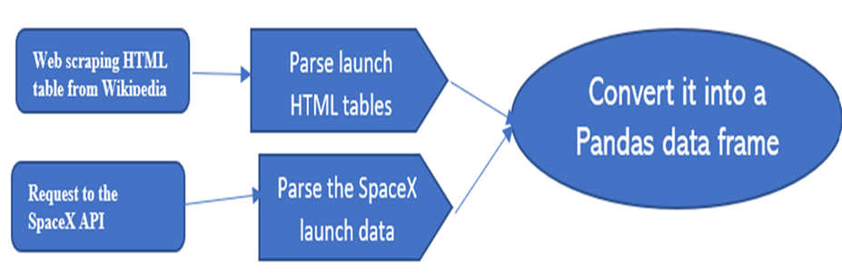
Data Collection
Method 1-Made Request to the SpaceX API
spacex_url=https://api.spacexdata.com/v4/launches/past
parse the SpaceX launch data using the GET request into pandas data frame
Method 2-Web scrap Falcon 9 launch records with BeautifulSoup:
Extract a Falcon 9 launch records HTML table from Wikipedia
url=https://en.wikipedia.org/w/index.php?title=List_of_Falcon_9_and_Falcon_Heavy_launches&oldid=1027686922
Parse launch HTML tables and convert it into a Pandas data frame

Slide 8
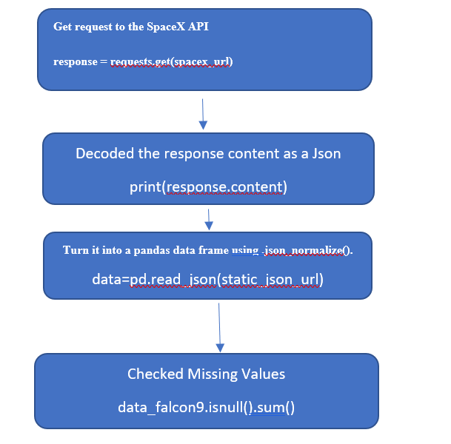
Data Collection – SpaceX API
Present your data collection with SpaceX REST calls using key phrases and flowcharts
url- https://eu-de.dataplatform.cloud.ibm.com/analytics/notebooks/v2/f0e2fcc1-fd0e-4f1c-b9db-37f7e0f21162/view?access_token=3bd269f61e015e7063bec1eb03bfb48e91dc76d978d7483e2556712dfd89706a

Slide 9
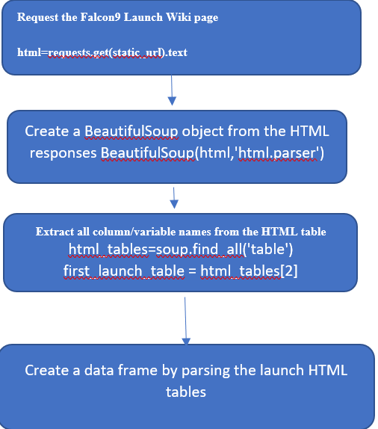
Data Collection - Scraping
https://eu-de.dataplatform.cloud.ibm.com/analytics/notebooks/v2/4eb17049-8ee9-4305-b3af-fcaddd3d18e8/view?access_token=429089ac4c62d88ede5552cda6090d2e8c00b71b17d8e2f5fcddf4ae15952d25

Slide 10
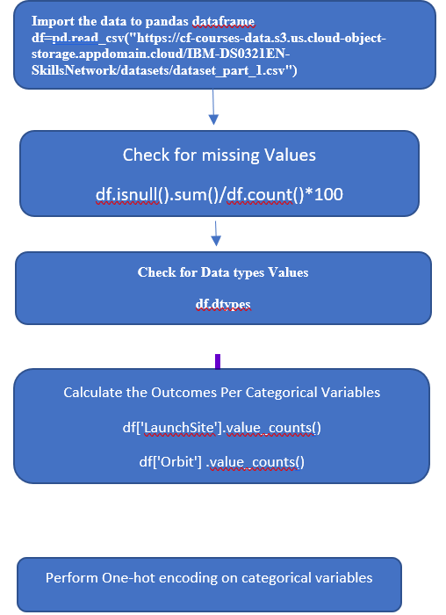
Data Wrangling
URL- https://eu-de.dataplatform.cloud.ibm.com/analytics/notebooks/v2/94ebd821-33a9-4c14-9438-74e5b21ed19d/view?access_token=37c5745276624128f0ac0cb4258424b679e26de9de4c398d85eee051f0254ae3

Slide 11
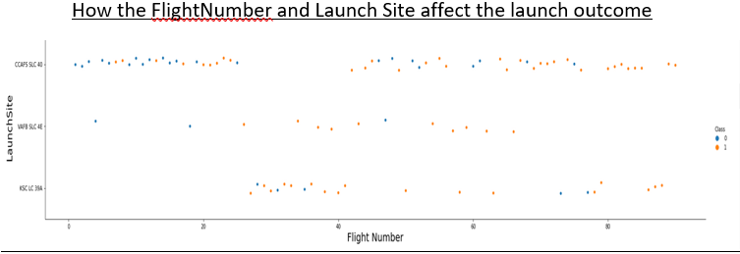
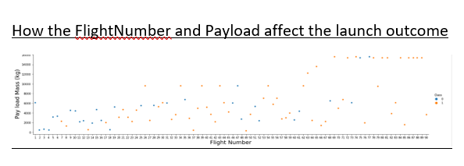
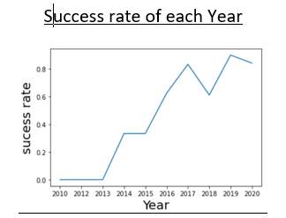
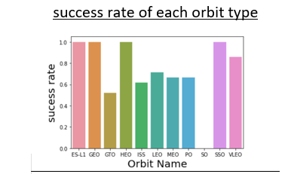
EDA with Data Visualization
URL- https://eu-de.dataplatform.cloud.ibm.com/analytics/notebooks/v2/14cfaae3-3e8f-4c07-9c85-c654f9def992/view?access_token=0270a7ae97b21f5ffed21d9dc99cc01104a260bd5864ae801718e1bfe92daac8

Slide 12

EDA with SQL
SQL queries you performed
%sql select distinct Launch_Site from SpacexTBL
%sql select Launch_Site from SpacexTBL where Launch_Site like '%CCA%' LIMIT 5;
%sql select sum(PAYLOAD_MASS__KG_) from SpacexTBL where CUSTOMER LIKE '%NASA (CRS)%’
%sql select avg(PAYLOAD_MASS__KG_) from SpacexTBL where Booster_Version LIKE '%F9 v1.1%’
%sql select min(Date) as Date,[Landing _Outcome] from SpacexTBL where [Landing _Outcome]='Success (ground pad)’
%sql select Customer,PAYLOAD_MASS__KG_ from SpacexTBL where (PAYLOAD_MASS__KG_ >4000 and PAYLOAD_MASS__KG_<6000) ;
%sql select Mission_Outcome,count(Mission_Outcome) as no from SpacexTBL group by Mission_Outcome
%sql select substring(Date,4,2) as Month,[Landing _Outcome],Booster_Version,Launch_Site from SpacexTBL where substring(Date,7,4) = '2015' and [Landing _Outcome]='Failure (drone ship)’
%sql select date,count([Landing _Outcome]) From SpacexTBL where Date between '04-06-2010' and '20-03-2017’\
and [Landing _Outcome] like '%Success%' group by [date] order by count([Landing _Outcome]) desc
url-https://eu-de.dataplatform.cloud.ibm.com/analytics/notebooks/v2/c94b1dd2-bff2-4359-ad06-88ad7a39c1d6/view?access_token=9acb7c1a7bc140514870ddb7489e6b84313eebe045f4a199d61b80ae2baae73e

Slide 13
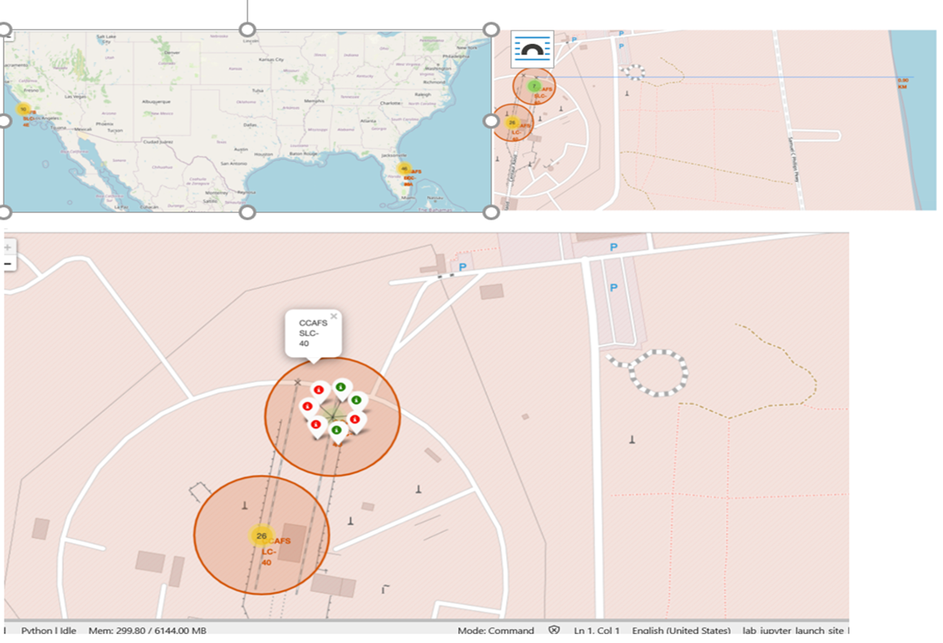
Build an Interactive Map with Folium
https://eu-de.dataplatform.cloud.ibm.com/analytics/notebooks/v2/8af77f77-413a-4dec-89d8-f5528f56ea67/view?access_token=bfb2c545abfa716e24ea6b0a1202ae16386edc99f94e12931ee5f6d7faff2c33

Slide 14
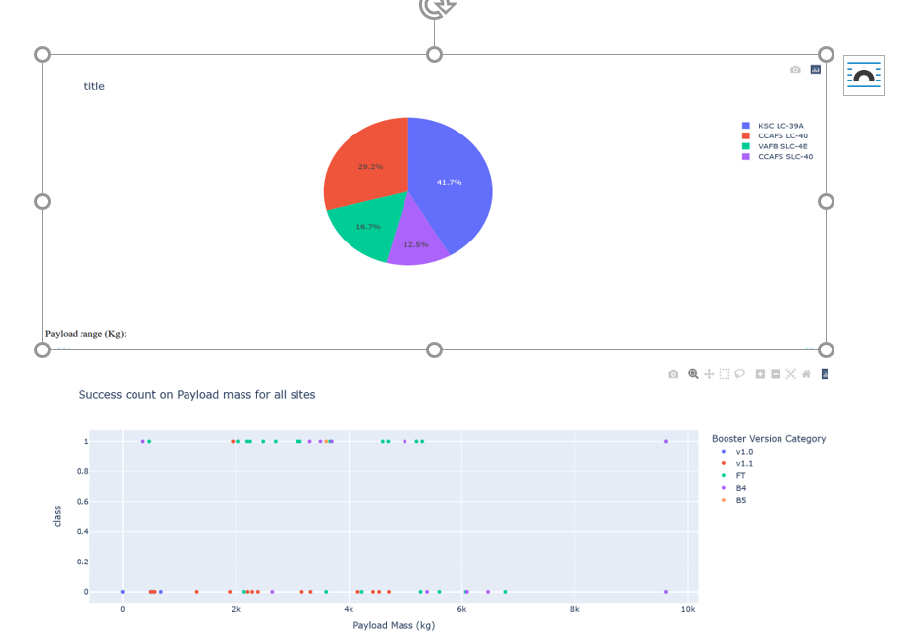
Build a Dashboard with Plotly Dash

Slide 15
Predictive Analysis (Classification)
We loaded the data into pandas data frame.
Then standardized
Split data into training and test data,
Then tuned different parameters using GridsSearchCV
We used the accuracy metrics to the check the accuracy of our models
We then got the best performing classification model
https://eu-de.dataplatform.cloud.ibm.com/analytics/notebooks/v2/52270107-fd72-4540-9960-340aba6d6c7b/view?access_token=01214c2d617ca35449deb4f5587565c00f239a526f91521226ff33cb63d6d931

Slide 16
Results
Exploratory data analysis results
Interactive analytics demo in screenshots
Predictive analysis results

Slide 17

Section 2

Slide 18
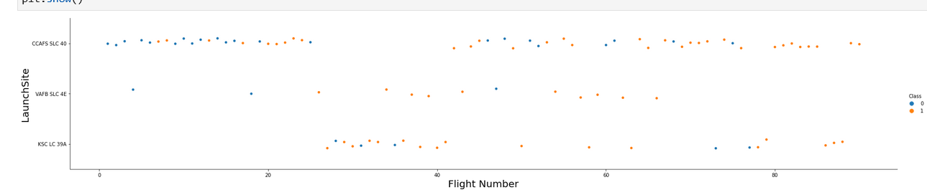
Flight Number vs. Launch Site
Success Rate increase with the number of flights

Slide 19
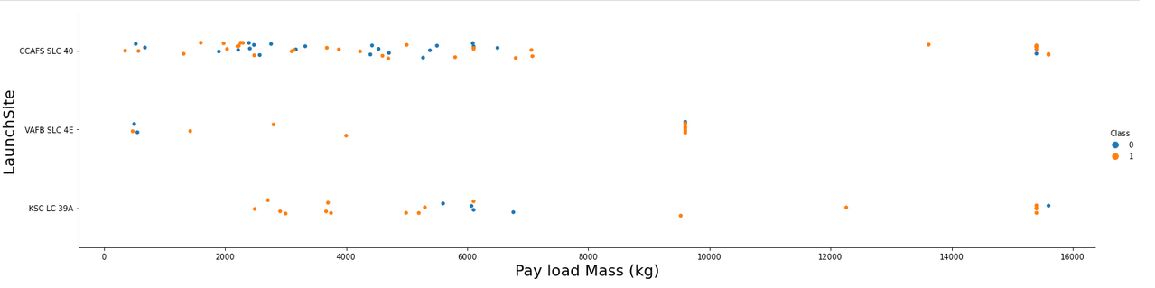
In VAFB-SLC launchsite there are no rockets launched for heavypayload mass(greater than 10000)
KSC LC 39A had the most failures at pay load mass between 5000 and 7000
Payload vs. Launch Site

Slide 20
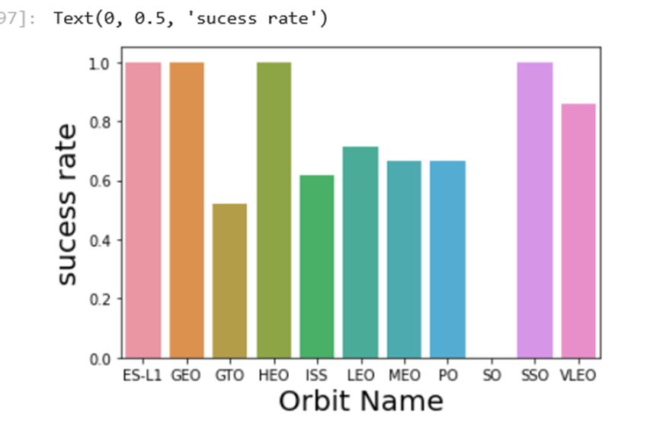
Success Rate vs. Orbit Type
The success rate is the highest in orbit ES-LI,GEO,HE0 and SSO ,GTO had the lowest success rate(0.5).

Slide 21
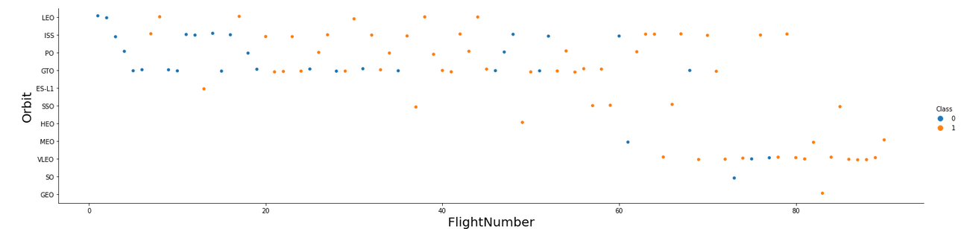
Flight Number vs. Orbit Type
For LEO orbit the Success appears related to the number of flights; on the other hand, there seems to be no relationship between flight number when in GTO orbit.

Slide 22
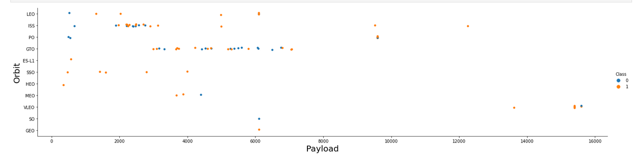
Payload vs. Orbit Type
Show a scatter point of payload vs. orbit type
Show the screenshot of the scatter plot with explanations

Slide 23
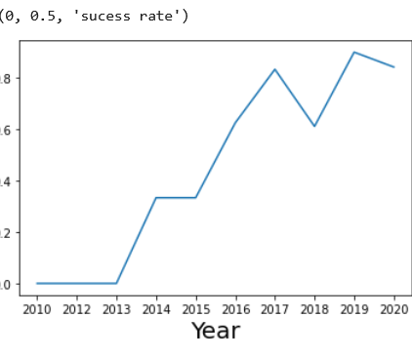
Launch Success Yearly Trend
You can observe that the success rate since 2013 kept increasing till 2020

Slide 24
All Launch Site Names
Launch Site
CCAFS LC-40
VAFB SLC-4E
KSC LC-39A
CCAFS SLC-40
%sql select distinct Launch_Sitefrom SpacexTBL
This is a sql query to pullUnique values of a column Launch_Site from table SpacexTBL

Slide 25
Launch Site Names Begin with 'CCA'
%sql select Launch_Site from SpacexTBL where Launch_Site like '%CCA%' LIMIT 5;
Launch Site
CCAFS LC-40
CCAFS LC-40
CCAFS LC-40
CCAFS LC-40
CCAFS LC-40

Slide 26
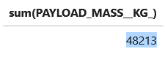
Total Payload Mass
%sql select sum(PAYLOAD_MASS__KG_) from SpacexTBL where CUSTOMER LIKE '%NASA (CRS)%’----sql query to sum PAYLOAD_MASS where customer is NASA (CRS)

Slide 27
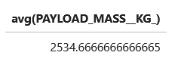
Average Payload Mass by F9 v1.1
%sql select avg(PAYLOAD_MASS__KG_) from SpacexTBL where Booster_Version LIKE '%F9 v1.1%')%’----sql query to Average PAYLOAD_MASS where Booster_Version is F9 v1.1

Slide 28
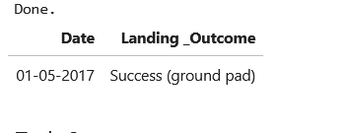
First Successful Ground Landing Date
%sql select min(Date) as Date,[Landing _Outcome] from SpacexTBL where [Landing _Outcome]='Success (ground pad)’---sql-Query to etract the First Successful Ground Landing Date

Slide 29
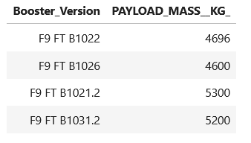
Successful Drone Ship Landing with Payload between 4000 and 6000
%sql select Booster_Version,PAYLOAD_MASS__KG_ from SpacexTBL where (PAYLOAD_MASS__KG_ >4000 and PAYLOAD_MASS__KG_<6000) and [Landing _Outcome]='Success (drone ship)’;---Sql query to extract the list

Slide 30
Total Number of Successful and Failure Mission Outcomes
%sql select Mission_Outcome,count(Mission_Outcome) as no from SpacexTBL ---sql query to extract the list
Mission_Outcome no
Failure (in flight) 1
Success 99
Success (payload status unclear) 1

Slide 31
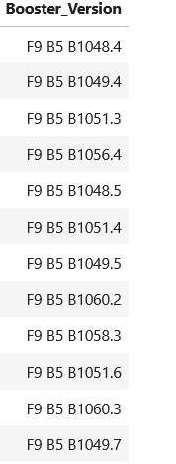
Boosters Carried Maximum Payload
%sql select Booster_Version from SpacexTBL where PAYLOAD_MASS__KG_=(select max(PAYLOAD_MASS__KG_) from SpacexTBL)-sql query to extract the list

Slide 32
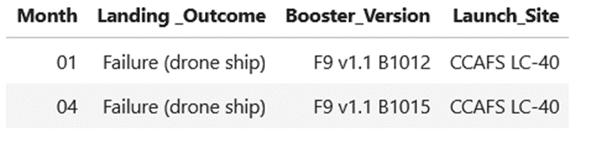
2015 Launch Records
%sql select substring(Date,4,2) as Month,[Landing _Outcome],Booster_Version,Launch_Site from SpacexTBL where substring(Date,7,4) = '2015' and [Landing _Outcome]='Failure (drone ship)’---sql query which will which will display the month names, failure landing_outcomes in drone ship ,booster versions, launch_site for the months in year 2015

Slide 33
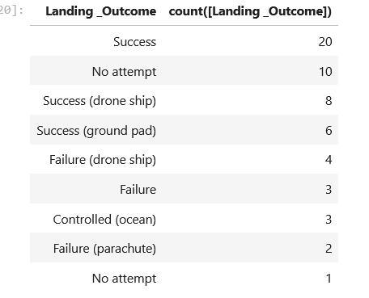
Rank Landing Outcomes Between 2010-06-04 and 2017-03-20
Sql query to pull the list

Slide 34

Section 3

Slide 35
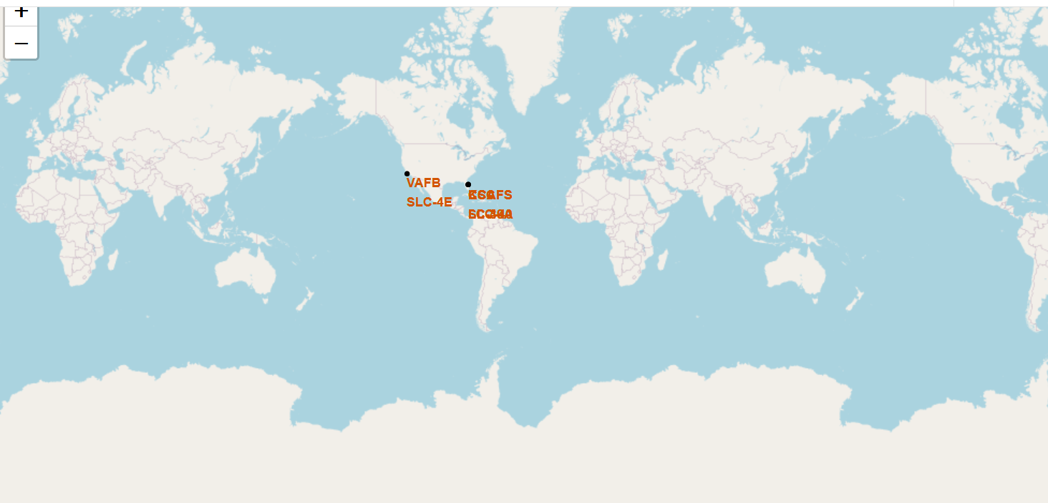
Interactive map of launch sites
Space x Lunch sites are the southern coastal part of America Florida and California

Slide 36
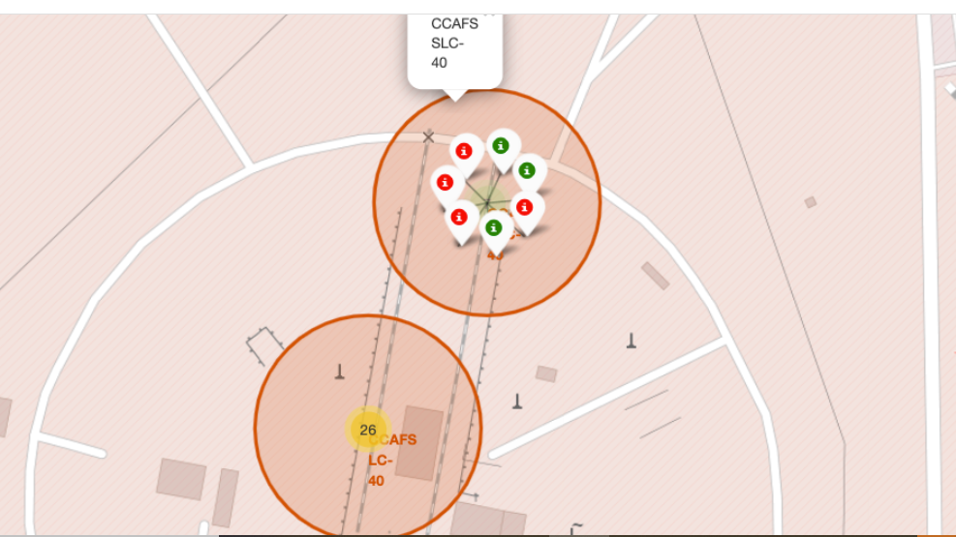
Markers showing launch sites with color labels

Slide 37
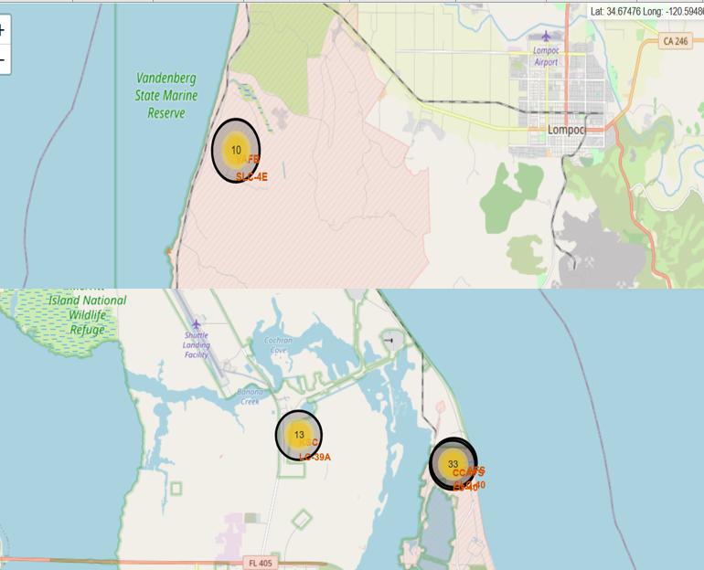
PolyLine between a launch site to the selected coastline point

Slide 38

Section 4

Slide 39
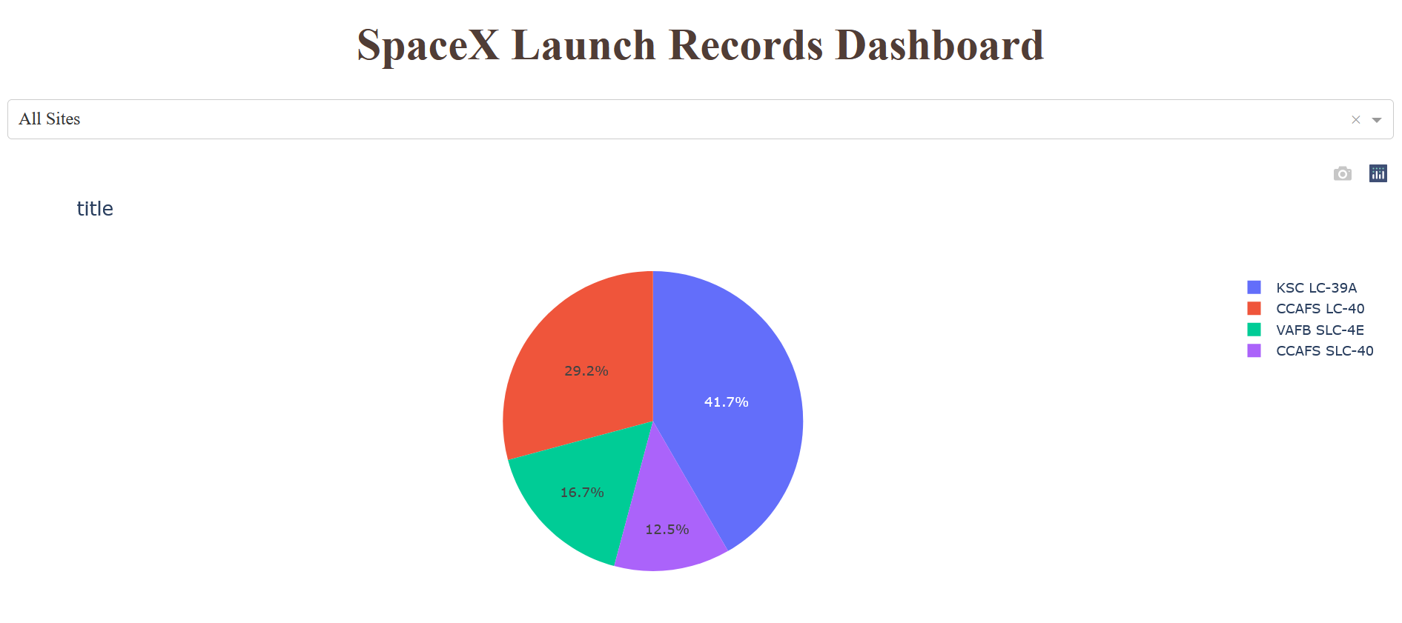
Launch success count for all sites

Slide 40
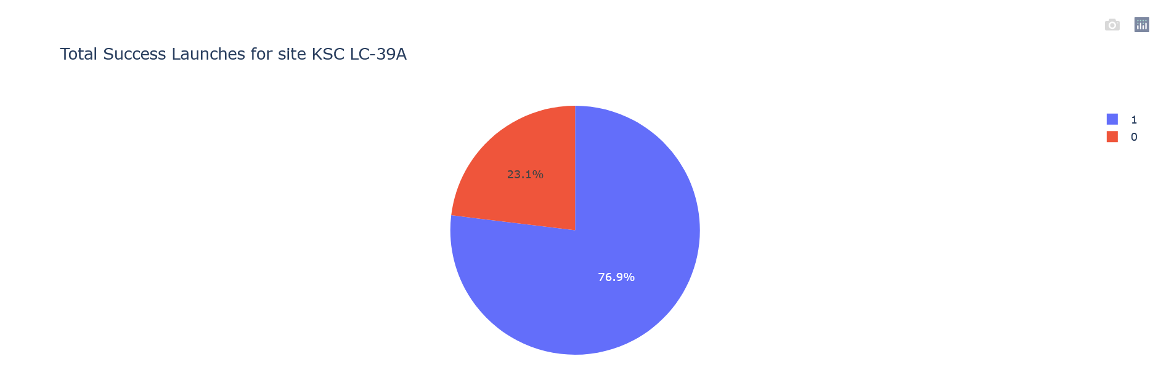
Pie chart showing the Launch site with the highest launch success ratio
Replace <Dashboard screenshot 2> title with an appropriate title
Show the screenshot of the piechart for the launch site with highest launch success ratio
Explain the important elements and findings on the screenshot

Slide 41
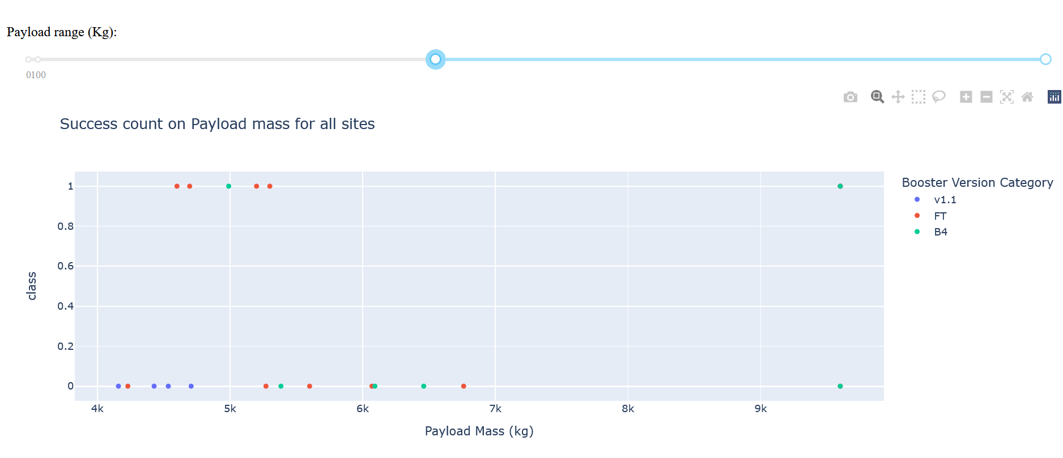
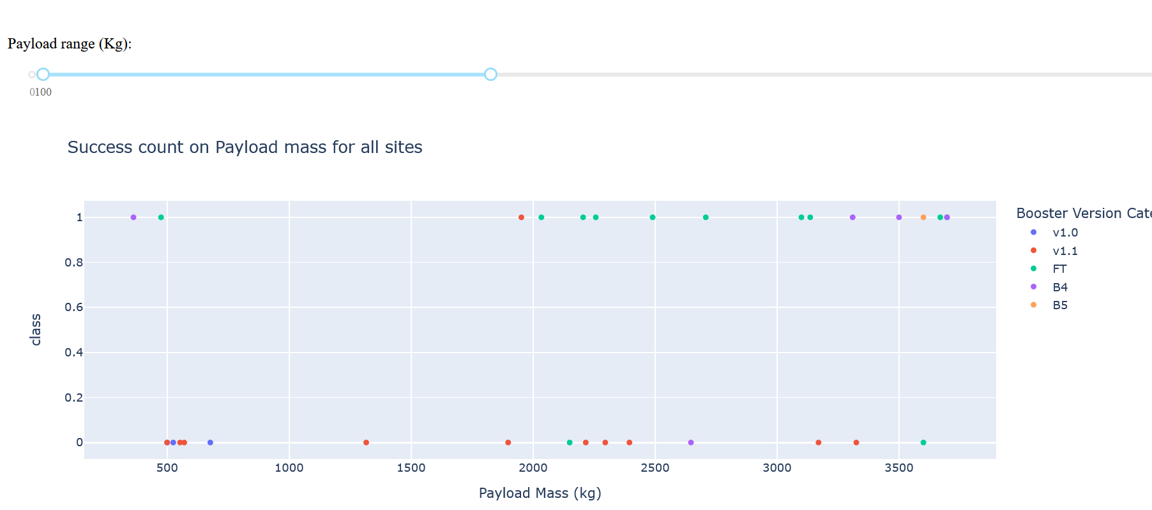
Payload vs. Launch Outcome scatter plot for all sites
Failure rate is higher with heavy payloads

Slide 42

Section 5

Slide 43
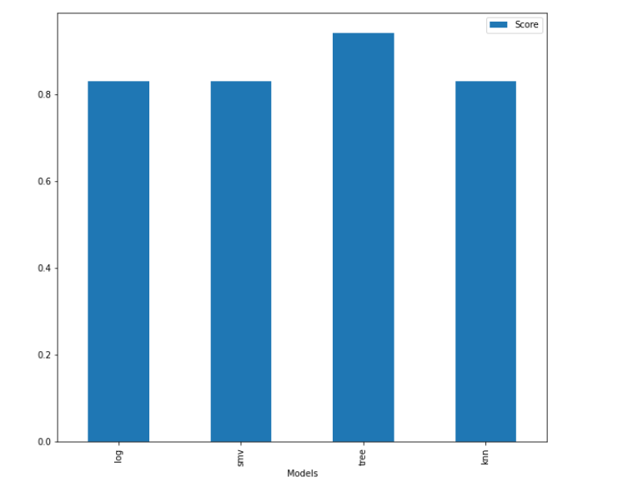
Classification Accuracy
Decision tree classifier Performed Best with a score of 94.4%

Slide 44
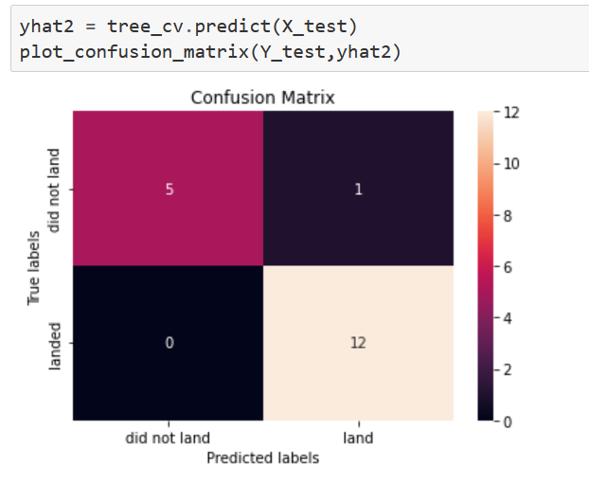
Decision Tree confusion matrix
The decision tree model is able to
Predict most outcome correctly
the accuracy is a bit lower in predicting
failures

Slide 45
Conclusions
The higher the number of flights at a launch site, the higher the chances of success
Success rate has been improving over years
Orbits ES-L1, GEO, HEO, SSO, VLEO had the most success rate
KSC LC-39A had the most successful launches of any sites.
Decision tree is the best classification model for this problem

Slide 46
Appendix
Include any relevant assets like Python code snippets, SQL queries, charts, Notebook outputs, or data sets that you may have created during this project

Slide 47


